Slide 1
Why use Excel to calculate probability?
It takes advantage of built-in macros that the software provides.
Makes the calculation quicker.
Reducing the possibility of a calculation error.

Slide 2
Here are some situations where a business might consider using a probability table:
Projecting growth based on data a marketing campaign provided.
Assessing potential delays to a project due to severe weather predictions
Creating a sales projection range to predict the most likely success levels for a product.
Performing risk assessment on a project to determine potential costs of risks the project faces.
Estimating delivery dates on a project

Slide 3
Important terms when calculating probability in Excel:
Table: Excel requires you to enter the information into a table of at least two columns and multiple rows of data.
Cell: The boxes in a table that contain your important pieces of data are called cells.
Limits: Setting boundaries for the range, known as the upper and lower limits.
Function: PROB function to find probabilities from a table of data and the SUM function to add a series of numbers.

Slide 4
How to find probabilities quickly using the PROB function:
1 . Gather the data
The more data points you enter into the probability table, the more versatile your table becomes, as it allows you to select more precise ranges for your probability calculations. By gathering data, you provide yourself with the information you need to calculate probabilities later as you are filling in your probability chart.

Slide 5
2. Label your chart
Labels ensure that anyone who sees the chart can quickly understand the data
3. Enter the category data
In order for a PROB function to work, all data in the column you're checking needs to be a numerical value, as the PROB function can not be used to find probability ranges based on text.

Slide 6
4. Sort by category
The PROB function requires you to sort the data in the table from low to high.
5. Calculate and enter your probabilities
Your data set includes probabilities for each label, enter each probability into the "Probability" column.
=SUM(Range)
Individual cell / SUM

Slide 7
6. Create a calculation table
To create your probability calculator, you need to create three new cells:
Lower limit:
Upper limit:
Probability:
=PROB( [top category cell] : [bottom category cell], [top probability cell] : [bottom probability cell], [cell next to "Lower limit:" label], [cell next to "Upper limit:" cell] )

Slide 8
Probability calculation examples
This example PROB calculation demonstrates how to create a probability calculation table in Excel. The first image shows what to enter into each cell to create the table. It also includes a row and column showing row numbers and column letters within Excel. The second image shows the probability calculation table a teacher might use to determine how many students will score a C or higher on an exam based on prior students' results:

Slide 9
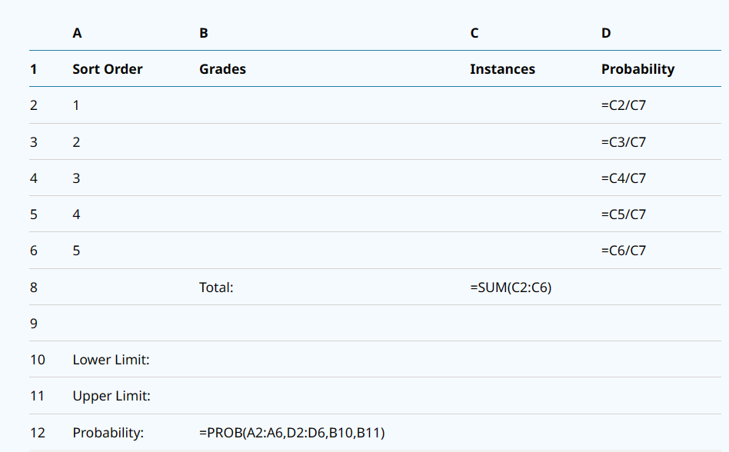

Slide 10
